Slide 1

Module 5.2 – Thread Execusion Efficiency
Performance Impact of Control Divergence

Slide 2
Objective
To learn to analyze the performance impact of control divergence
Boundary condition checking
Control divergence is data-dependent

Slide 3
Performance Impact of Control Divergence
Boundary condition checks are vital for complete functionality and robustness of parallel code
The tiled matrix multiplication kernel has many boundary condition checks
The concern is that these checks may cause significant performance degradation
For example, see the tile loading code below:
if(Row < Width && t * TILE_WIDTH+tx < Width) {
ds_M[ty][tx] = M[Row * Width + p * TILE_WIDTH + tx];
} else {
ds_M[ty][tx] = 0.0;
}
if (p*TILE_WIDTH+ty < Width && Col < Width) {
ds_N[ty][tx] = N[(p*TILE_WIDTH + ty) * Width + Col];
} else {
ds_N[ty][tx] = 0.0;
}

Slide 4
Two types of blocks in loading M Tiles
1. Blocks whose tiles are all within valid range until the last phase.
2. Blocks whose tiles are partially outside the valid range all the way
M
Type 1
TILE_WIDTH
Type 2

Slide 5
Analysis of Control Divergence Impact
Assume 16x16 tiles and thread blocks
Each thread block has 8 warps (256/32)
Assume square matrices of 100x100
Each thread will go through 7 phases (ceiling of 100/16)
There are 49 thread blocks (7 in each dimension)

Slide 6
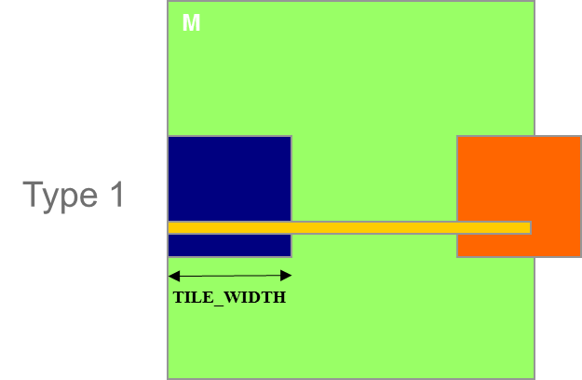
Control Divergence in Loading M Tiles
Assume 16x16 tiles and thread blocks
Each thread block has 8 warps (256/32)
Assume square matrices of 100x100
Each warp will go through 7 phases (ceiling of 100/16)
There are 42 (6*7) Type 1 blocks, with a total of 336 (8*42) warps
They all have 7 phases, so there are 2,352 (336*7) warp-phases
The warps have control divergence only in their last phase
336 warp-phases have control divergence

Slide 7
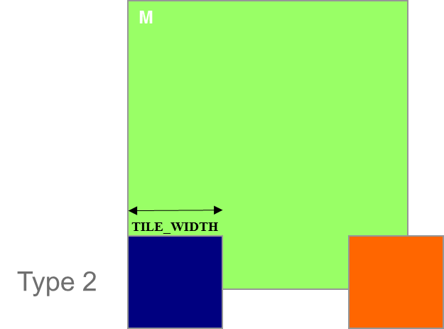
Control Divergence in Loading M Tiles (Type 2)
Type 2: the 7 block assigned to load the bottom tiles, with a total of 56 (8*7) warps
They all have 7 phases, so there are 392 (56*7) warp-phases
The first 2 warps in each Type 2 block will stay within the valid range until the last phase
The 6 remaining warps stay outside the valid range
So, only 14 (2*7) warp-phases have control divergence

Slide 8
Overall Impact of Control Divergence
Type 1 Blocks: 336 out of 2,352 warp-phases have control divergence
Type 2 Blocks: 14 out of 392 warp-phases have control divergence
The performance impact is expected to be less than 12% (350/2,944 or (336+14)/(2352+14))
M
Type 1
TILE_WIDTH
Type 2

Slide 9
Additional Comments
The calculation of impact of control divergence in loading N tiles is somewhat different and is left as an exercise
The estimated performance impact is data dependent.
For larger matrices, the impact will be significantly smaller
In general, the impact of control divergence for boundary condition checking for large input data sets should be insignificant
One should not hesitate to use boundary checks to ensure full functionality
The fact that a kernel is full of control flow constructs does not mean that there will be heavy occurrence of control divergence
We will cover some algorithm patterns that naturally incur control divergence (such as parallel reduction) in the Parallel Algorithm Patterns modules

Slide 10
The GPU Teaching Kit is licensed by NVIDIA and the University of Illinois under the Creative Commons Attribution-NonCommercial 4.0 International License.

